Slide 1
CSS Properties

Slide 2
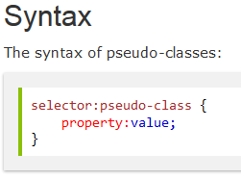
Pseudo-classes
A pseudo-class is used to define a special state of an element.
For example, it can be used to:
Style an element when a user mouses over it
Style visited and unvisited links differently
Example 1

Slide 3
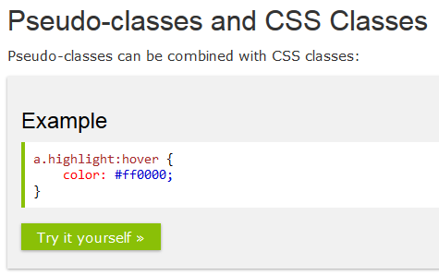
Pseudo-classes
Example 2

Slide 4
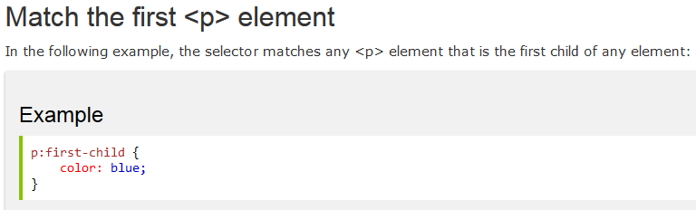
Pseudo-classes
The :first-child Pseudo-class
It pseudo-class matches a specified element that is the first child of another element.
Example 3

Slide 5
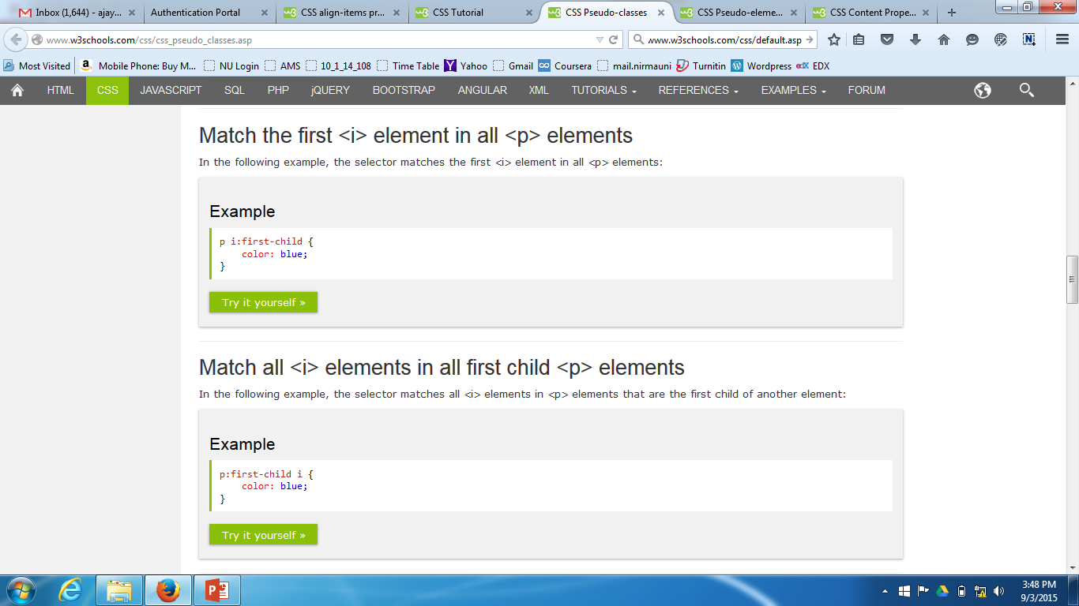
Pseudo-classes
Example 4 Example 5

Slide 6
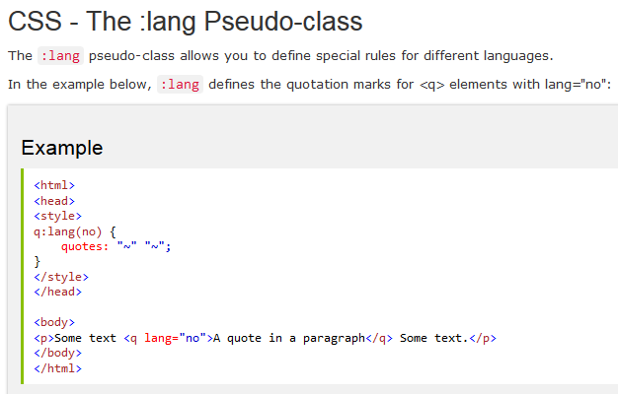
Pseudo-classes
Example 6 All CSS classes

Slide 7
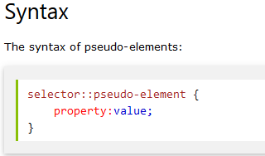
Pseudo-element
A CSS pseudo-element is used to style specified parts of an element.
For example, it can be used to:
Style the first letter, or line, of an element
Insert content before, or after, the content of an element

Slide 8
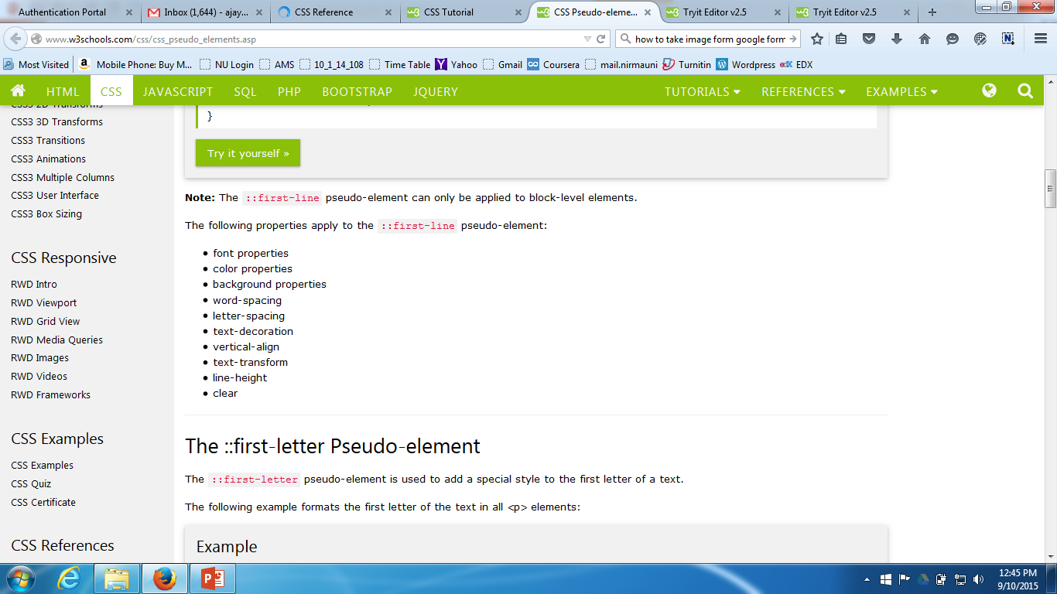
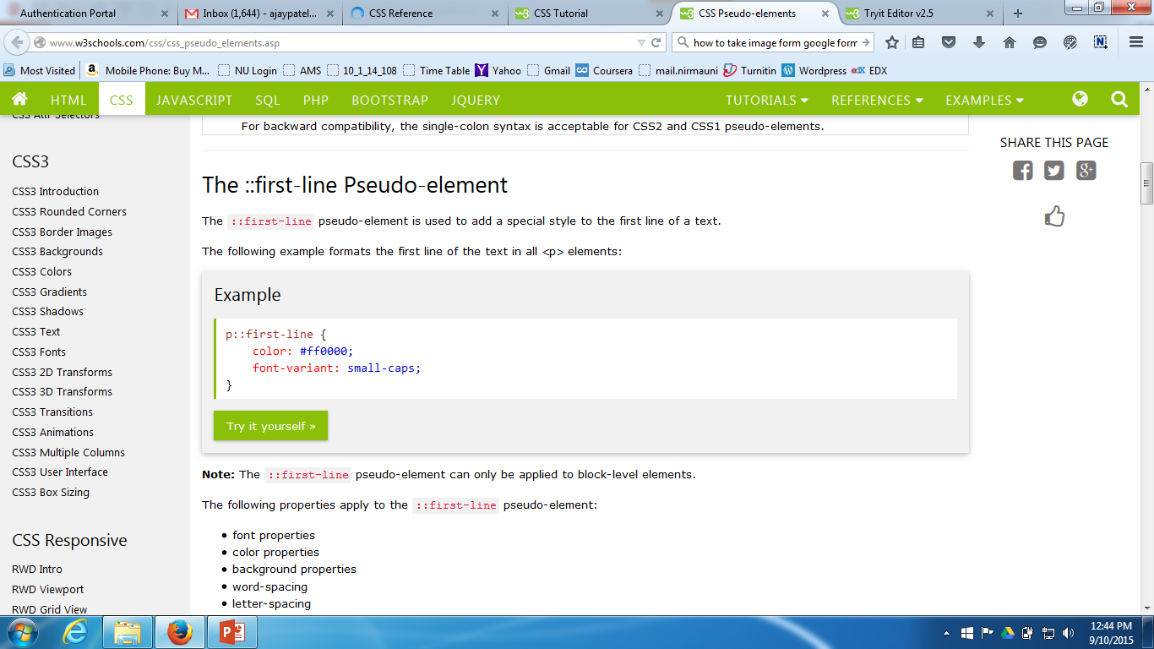
Pseudo-element
The ::first-line Pseudo-element
The ::first-line pseudo-element is used to add a special style to the first line of a text.
The following example formats the first line of the text in all <p> elements
Example

Slide 9
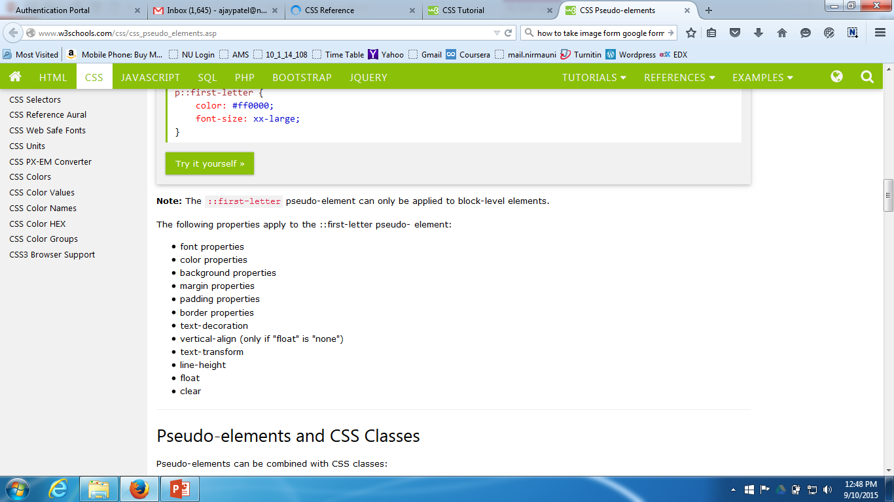
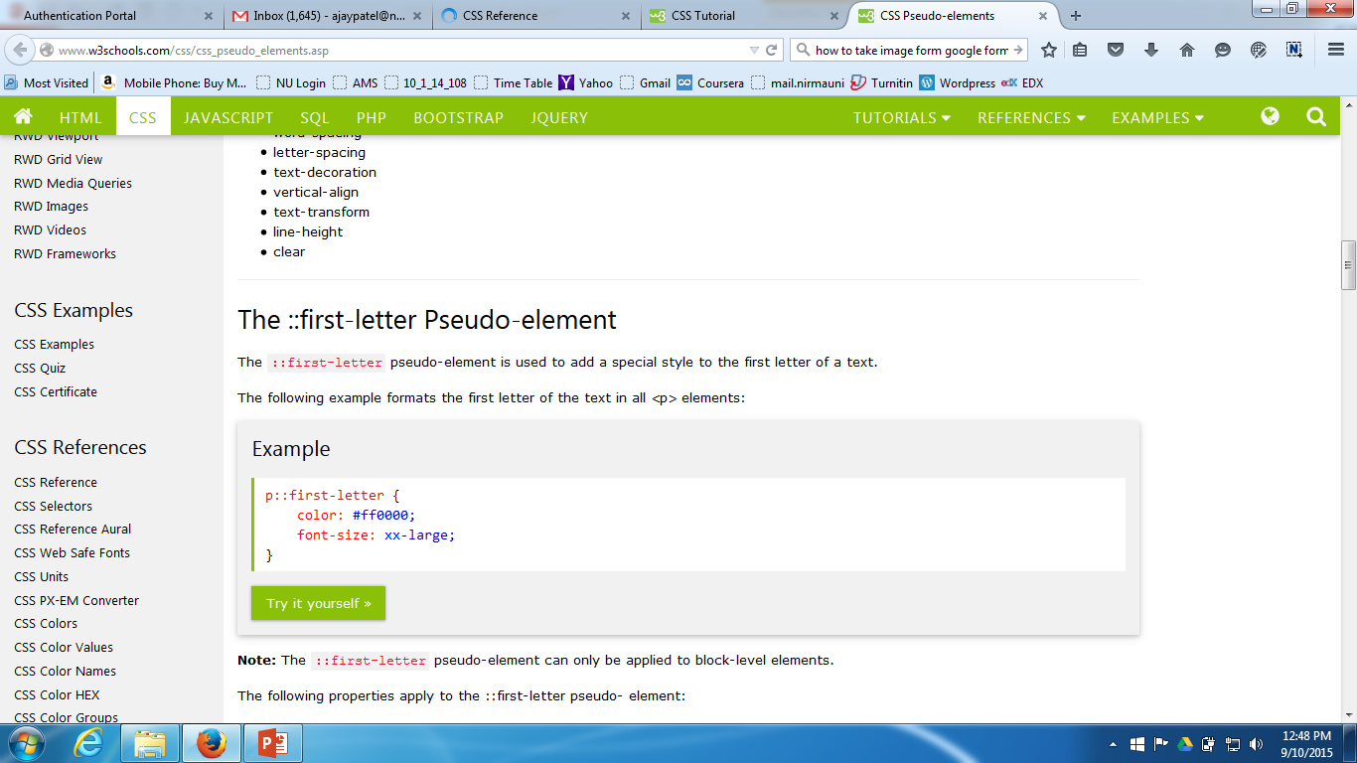
Pseudo-element
The ::first-letter Pseudo-element
The ::first-letter pseudo-element is used to add a special style to the first letter of a text.
The following example formats the first letter of the text in all <p> elements:
Example

Slide 10
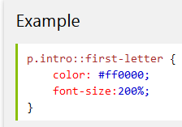
Pseudo-element
Pseudo-elements and CSS Classes
Pseudo-elements can be combined with CSS classes:
Example
The example above will display the first letter of paragraphs with class="intro", in red and in a larger size.

Slide 11
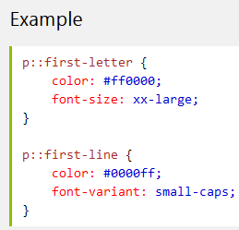
Pseudo-element
Multiple Pseudo-elements
Several pseudo-elements can also be combined.
In the following example, the first letter of a paragraph will be red, in an xx-large font size. The rest of the first line will be blue, and in small-caps. The rest of the paragraph will be the default font size and color:
Example

Slide 12
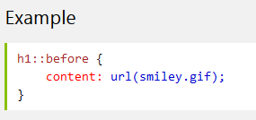
Pseudo-element
CSS - The ::before Pseudo-element
It can be used to insert some content before the content of an element.
The following example inserts an image before each <h1> element:
Example

Slide 13
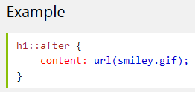
Pseudo-element
CSS - The ::after Pseudo-element
It pseudo-element can be used to insert some content after the content of an element.
The following example inserts an image after each <h1> element:
Example

Slide 14
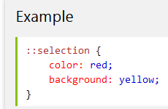
Pseudo-element
CSS - The ::selection Pseudo-element
It pseudo-element matches the portion of an element that is selected by a user.
The following CSS properties can be applied to ::selection: color, background, cursor, and outline.
The following example makes the selected text red on a yellow background:
Example

Slide 15
Pseudo-element
All CSS Pseudo Elements

Slide 16
content Property
The content property is used with the :before and :after pseudo-elements, to insert generated content.
Example

Slide 17
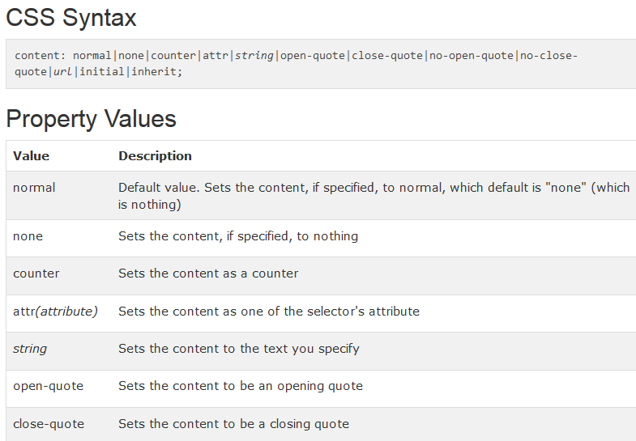
content Property

Slide 18
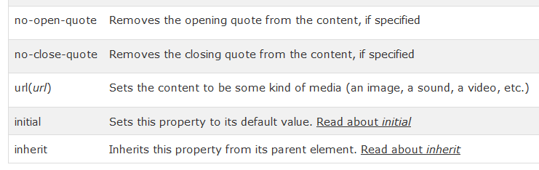
content Property

Slide 19
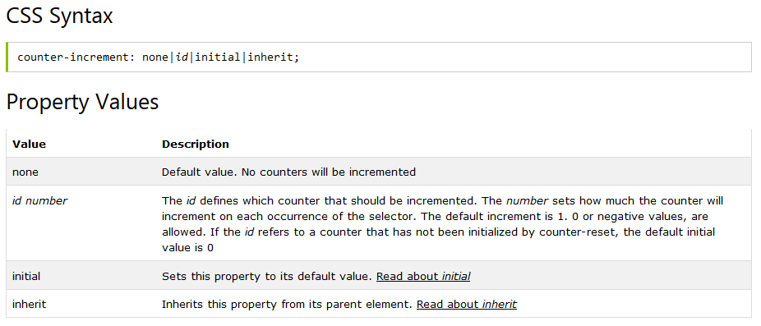
counter-increment Property
The counter-increment property increments one or more counter values.
The counter-increment property is usually used together with the counter-reset property and the content property.
Example

Slide 20
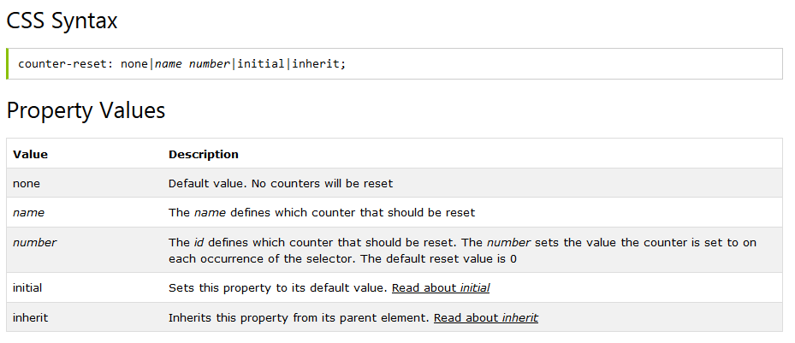
counter-reset Property
The counter-reset property creates or resets one or more counters.
The counter-reset property is usually used together with the counter-increment property and the content property.
Example

Slide 21
Text Properties

Slide 22
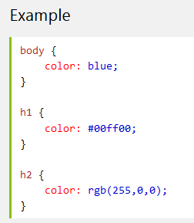
Text Color Property
The color property is used to set the color of the text.

Slide 23
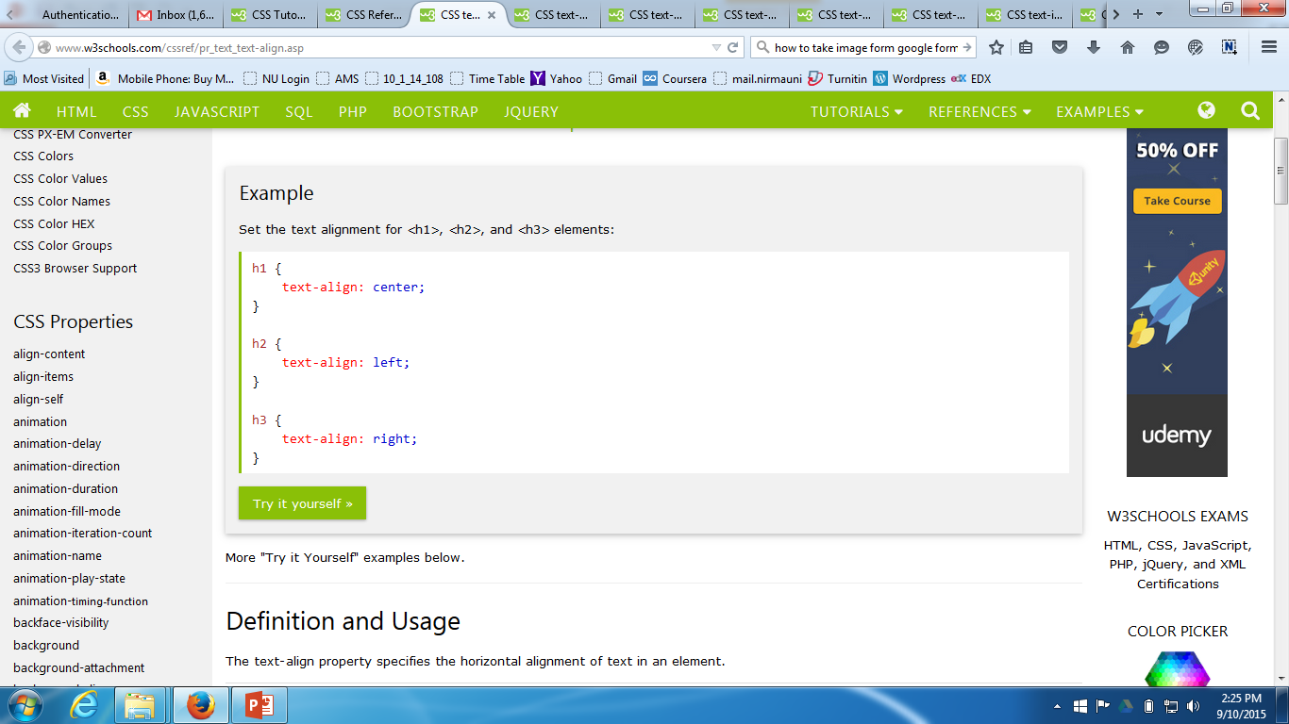
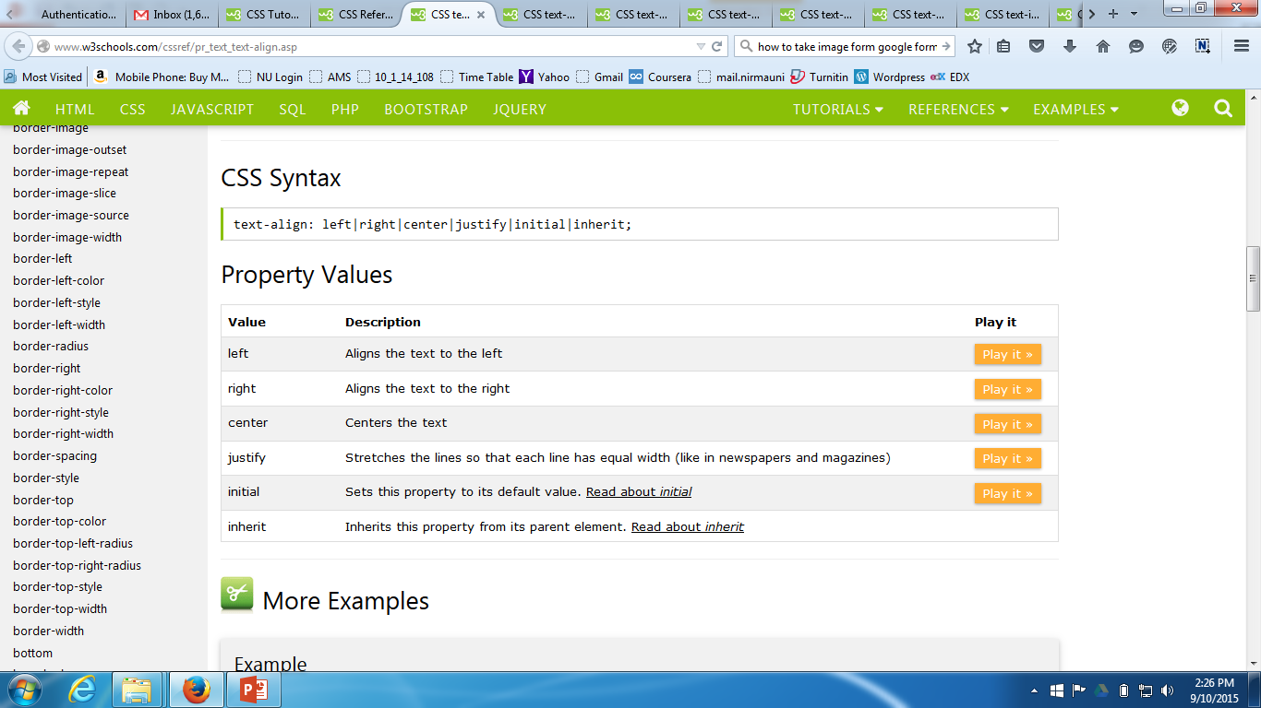
text-align Property
The text-align property specifies the horizontal alignment of text in an element.

Slide 24
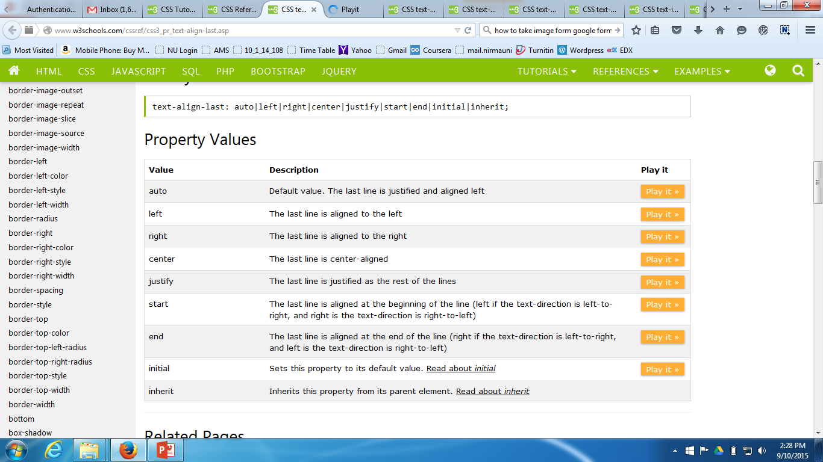
text-align-last Property
The text-align-last property specifies how to align the last line of a text.
Example

Slide 25
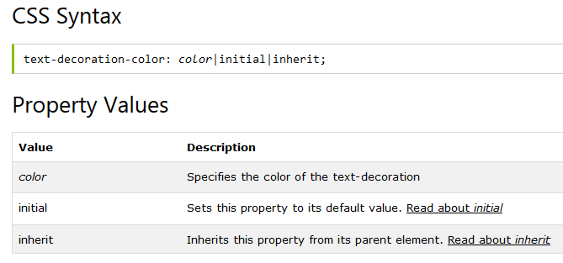
text-decoration-color Property
The text-decoration-color property specifies the color of the text-decoration (underlines, overlines, linethroughs).
Note: The text-decoration-color property will only have an effect on elements with a visible text-decoration.
Example

Slide 26
text-decoration-line Property
The text-decoration-line property specifies what type of line, if any, the decoration will have.
Note: You can also set the text-decoration-line using the text-decoration property, which is a short-hand property for the text-decoration-line, text-decoration-style, and the text-decoration-color properties.
Note: You can also combine more than one value, like underline and overline to display lines both under and over the text.
Example

Slide 27
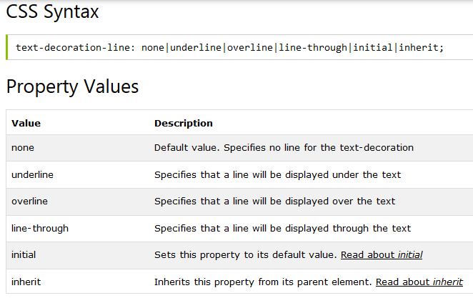
text-decoration-line Property

Slide 28
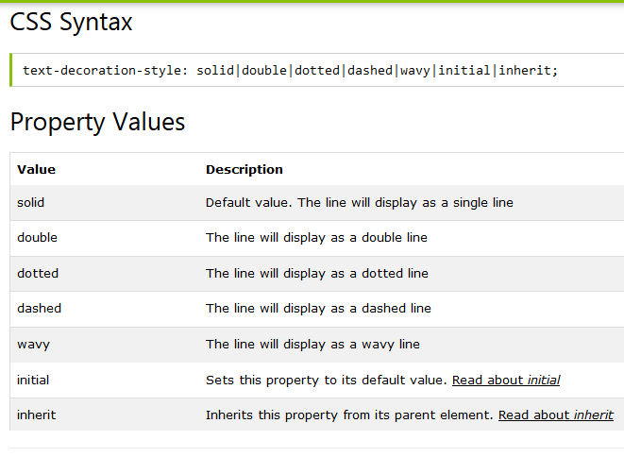
text-decoration-style Property
The text-decoration-style property specifies how the line, if any, will display.
Example

Slide 29
text-decoration-style Property
The text-decoration-style property specifies how the line, if any, will display.
Example

Slide 30
text-decoration Property
The text-decoration property specifies the decoration added to text.
Note: In CSS3, the text-decoration property is a shorthand property for text-decoration-line, text-decoration-color, and text-decoration-style, but this is currently not supported in any of the major browsers.
Note: In CSS3 you can use the text-decoration-color property to change the color of the decoration, otherwise the color is the same as the color of the text.
Example

Slide 31
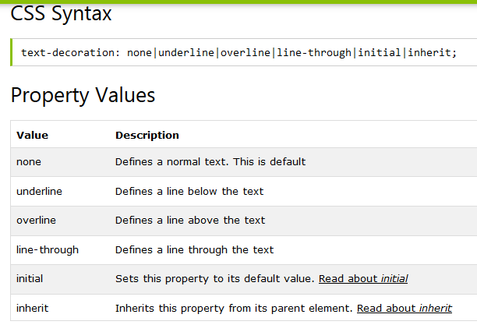
text-decoration Property

Slide 32
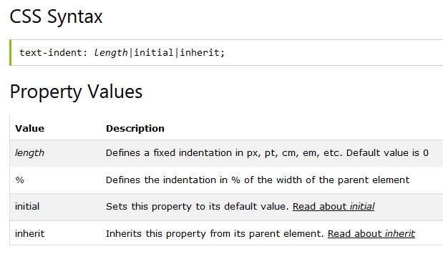
text-indent Property
The text-indent property specifies the indentation of the first line in a text-block.
Note: Negative values are allowed. The first line will be indented to the left if the value is negative.
Example

Slide 33
text-justify Property
The text-justify property specifies the justification method to use when text-align is set to "justify".
This property specifies how justified text should be aligned and spaced.
Example

Slide 34
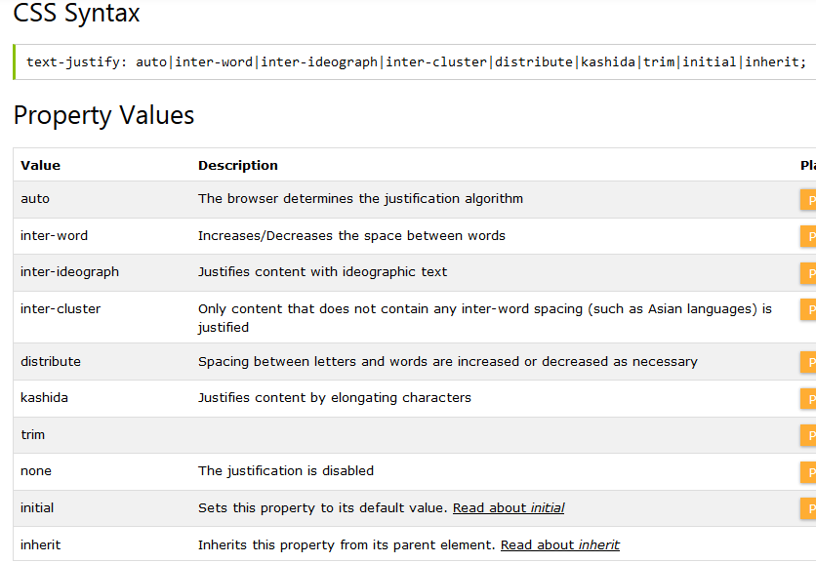
text-justify Property

Slide 35
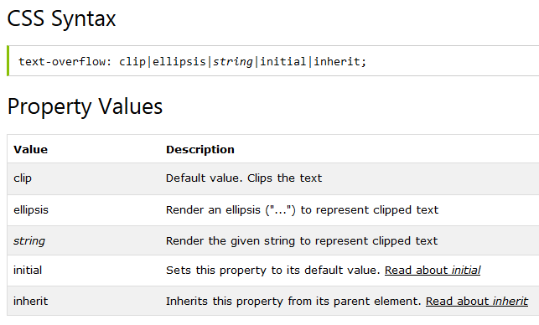
text-overflow Property
The text-overflow property specifies how overflowed content that is not displayed should be signaled to the user.
Example

Slide 36
text-shadow Property
The text-shadow property adds shadow to text.
This property accepts a comma-separated list of shadows to be applied to the text.
Example

Slide 37
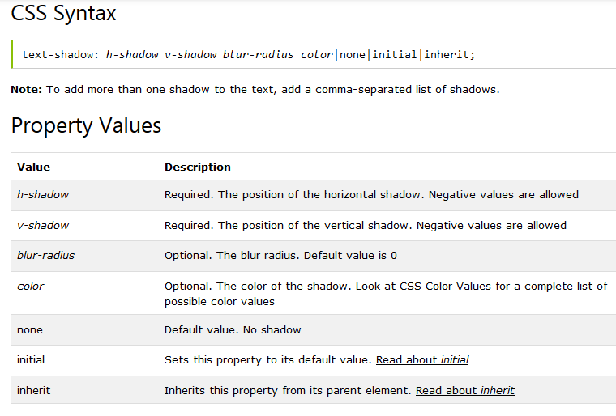
text-shadow Property

Slide 38
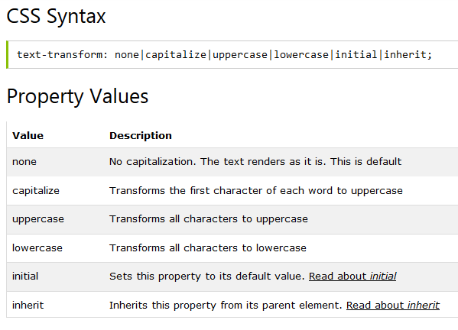
text-transform Property
The text-transform property controls the capitalization of text.
Example

Slide 39
CSS3 Transitions
CSS3 transitions allows you to change property values smoothly (from one value to another), over a given duration.
Example: Mouse over the element below to see a CSS3 transition effect

Slide 40
How to Use CSS3 Transitions?
To create a transition effect, you must specify two things:
the CSS property you want to add an effect to
the duration of the effect
Note: If the duration part is not specified, the transition will have no effect, because the default value is 0.
Example

Slide 41
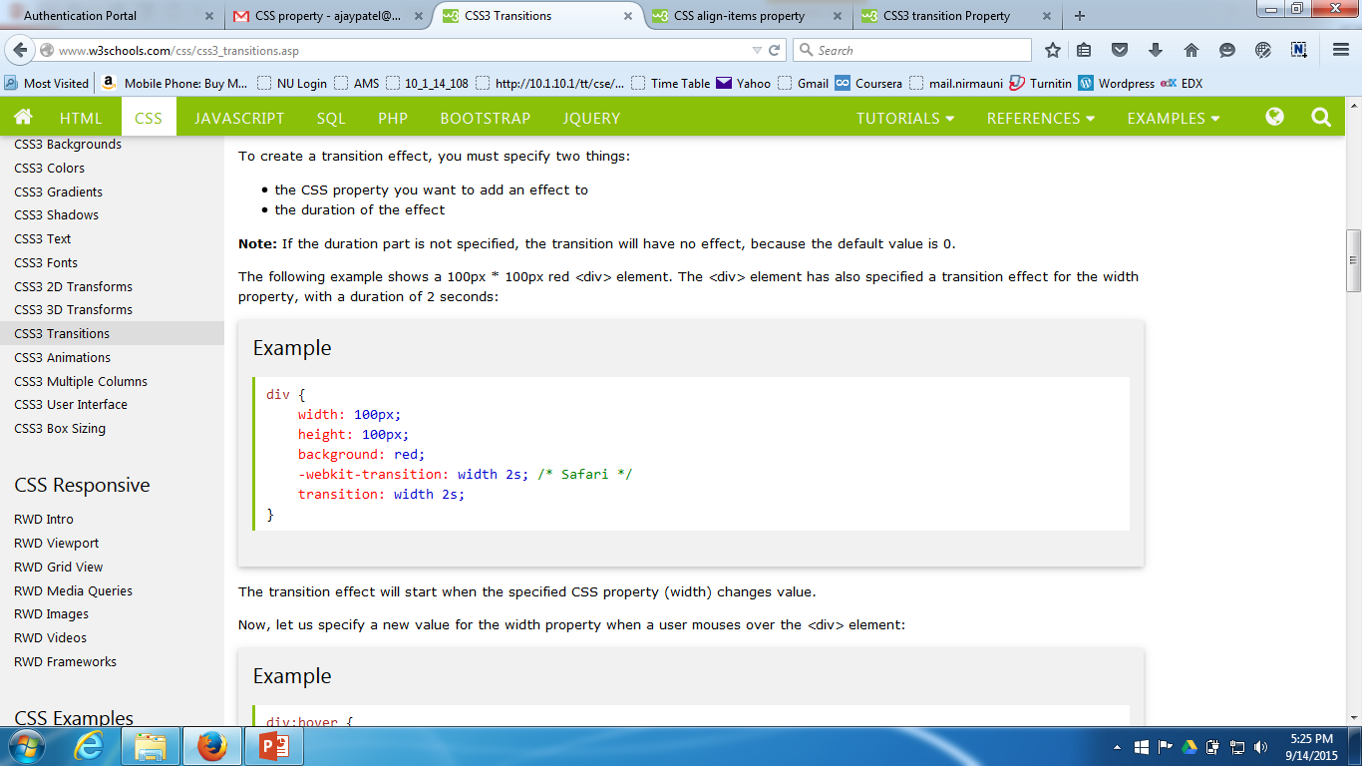
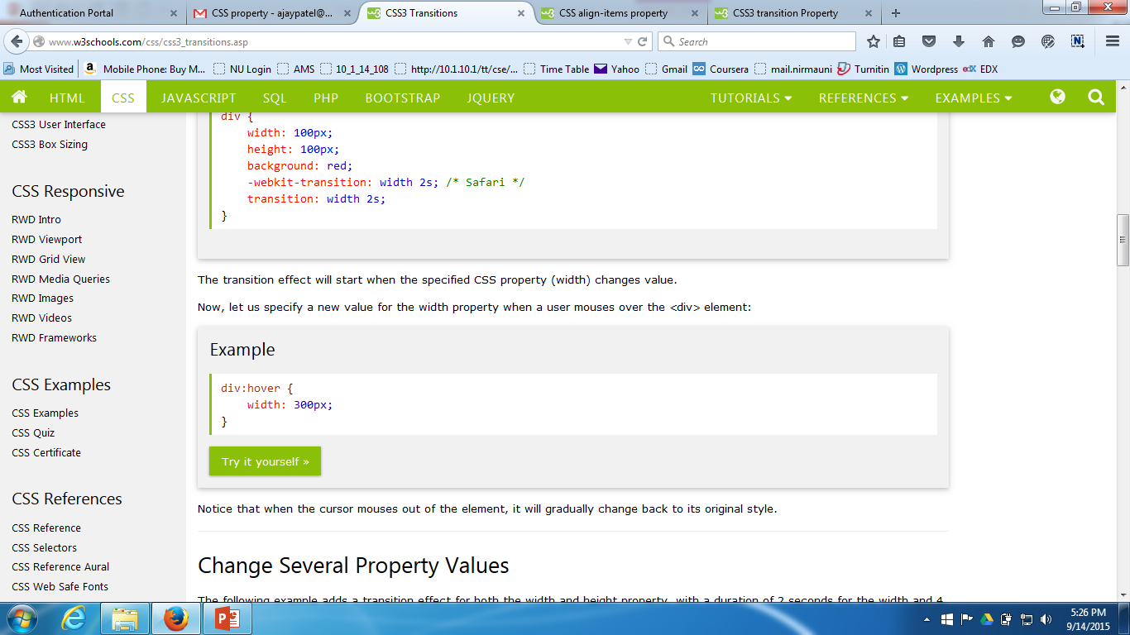
How to Use CSS3 Transitions?
The following example shows a 100px * 100px red <div> element. The <div> element has also specified a transition effect for the width property, with a duration of 2 seconds:

Slide 42
transition-property Property
The transition-property property specifies the name of the CSS property the transition effect is for (the transition effect will start when the specified CSS property changes).
Tip: A transition effect could typically occur when a user hover over an element.
Note: Always specify the transition-duration property, otherwise the duration is 0, and the transition will have no effect.
Example

Slide 43
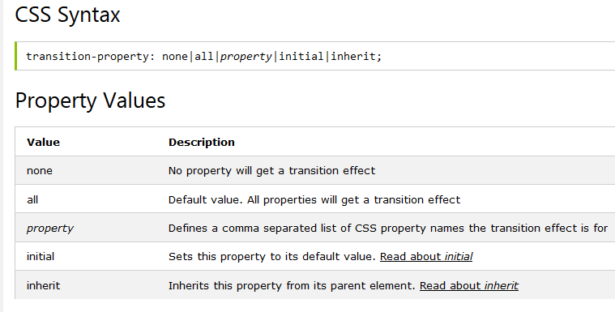
transition-property Property

Slide 44
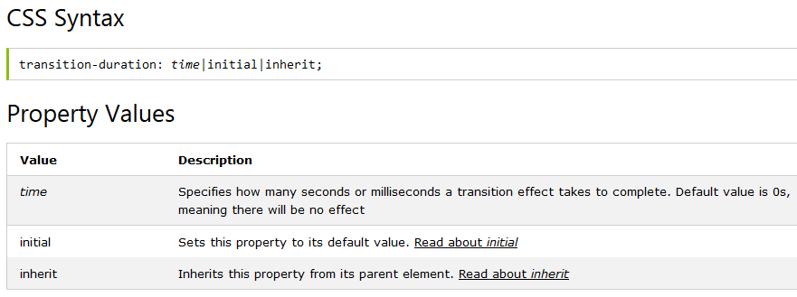
transition-duration Property
The transition-duration property specifies how many seconds (s) or milliseconds (ms) a transition effect takes to complete.
Example

Slide 45
transition-timing-function Property
The transition-timing-function property specifies the speed curve of the transition effect.
This property allows a transition effect to change speed over its duration.
Example

Slide 46
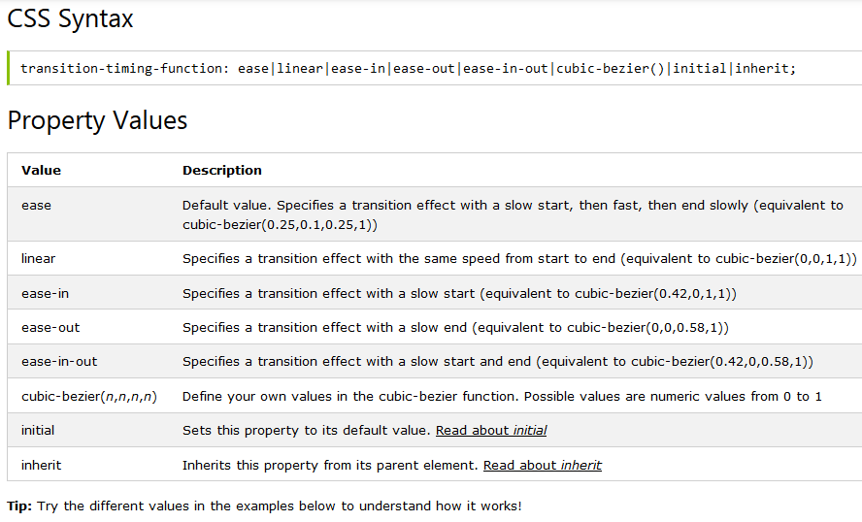
transition-timing-function Property

Slide 47
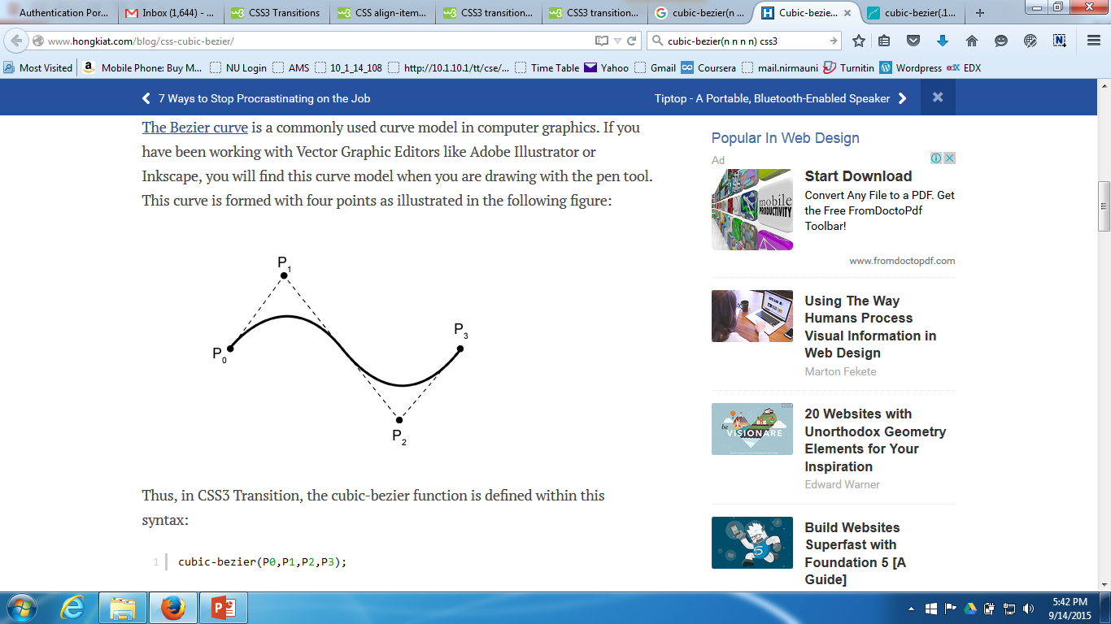
transition-timing-function Property
Bezier Curve
The Bezier curve is a commonly used curve model in computer graphics. If you have been working with Vector Graphic Editors like Adobe Illustrator or Inkscape, you will find this curve model when you are drawing with the pen tool. This curve is formed with four points as illustrated in the following figure:

Slide 48
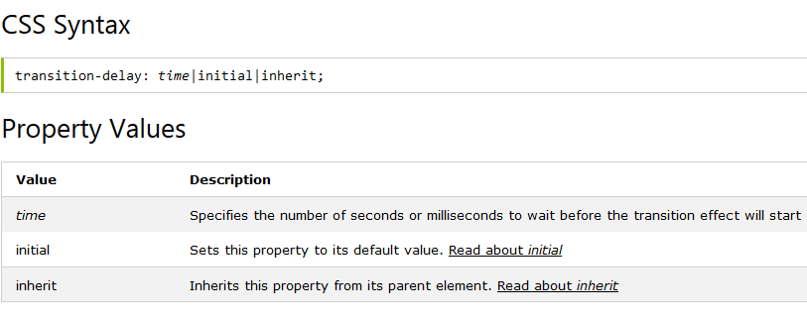
transition-delay Property
The transition-delay property specifies when the transition effect will start.
The transition-delay value is defined in seconds (s) or milliseconds (ms).
Example

Slide 49
transition Property
The transition property is a shorthand property for the four transition properties:
transition-property, transition-duration, transition-timing-function, and transition-delay.
Note: Always specify the transition-duration property, otherwise the duration is 0s, and the transition will have no effect.
Example

Slide 50
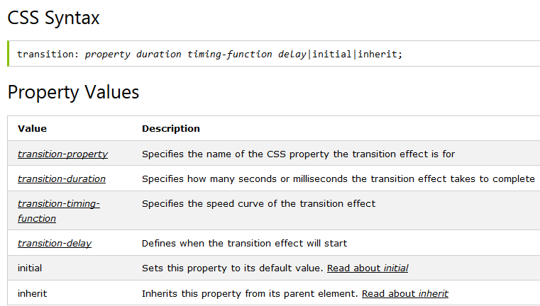
transition Property

Slide 51
References
http://www.w3schools.com/cssref/

Slide 52
Thank You…

